Slide 1
Agenda – WVD Discussion
Introductions
Discuss your institution’s VDI today & what the team is looking for in terms of key capabilities or outcomes
Walk through WVD in the context of your goals, including in-depth demos
Discuss where there is a good fit/where we see gaps
Wrap up & agree on next steps and open action items
Rich McBrine
Principal Cloud Solutions Architect
Microsoft, U.S. Education
rich.mcbrine@microsoft.com

Slide 2


Windows Virtual Desktop Spring Update in EDU
Rich McBrine
Principal Cloud Solutions Architect
Microsoft, U.S. Education
rich.mcbrine@microsoft.com

Slide 3

Agenda
What's in the WVD update
Demo WVD v2
Dig into diagnostics improvements
What we know about WVD v1 to WVD v2 migration
LOTS of Q&A
Coming soon: MSIX App Attach

Slide 4
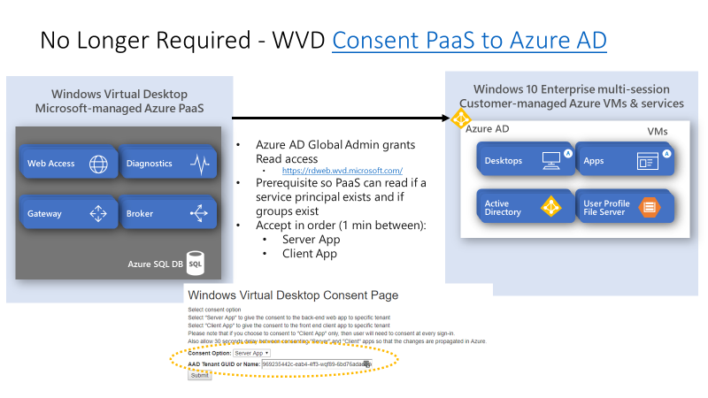
What’s included in the Spring 2020 service update
Integration with Azure Resource Manager (ARM)
Azure portal support for creation, management and diagnostics
Azure AD user group for app and desktop publishing
Uses Azure Role-Based Access Control (RBAC)
PowerShell (PS) integrated with AZ PS module
Integrated with Log Analytics
Selection of service metadata storage location
WVD app no longer requires consent by Azure AD
Global Admin to read the directory
Notes:
Privacy, regulatory controls – service metadata storage location will be important

Slide 5
Notable Notables
Major revisions:
WVD “Tenant” concept is gone (we finally got rid of that confusing thing)
Azure Portal is central means of management
WVD is a first-party, integrated Azure service
Organizational Constructs are different (next slide):
Workspaces are the focal point of deployment – organize Apps/Desktops for consumption
Workspaces can combine multiple Application Groups
Host Pools underpin Applications Groups with horsepower
Desktops and Apps can both be published from a given Host Pool to the same user/group
PowerShell updated to first-party
Same old song and dance:
AD and AAD both still required (AAD solo is on roadmap)
No “Guest” account access – all users must be native users of your sync’d AAD & AD
WVD v1 deployments remain "as is" - no portal integration or other benefits until migrated to v2
In-flight:
Migration from existing PRD environments currently planned via PowerShell scripts

Slide 6

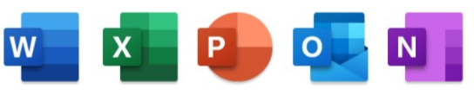


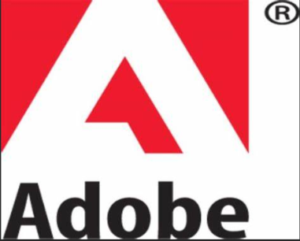

New Constructs & Inter-relationships
Azure Subscription
WVD Workspace N….
WVD Workspace
Application Group B
+ DAG
Application Group C - DAG
Application Group A
Published
Desktop
App Group
Application Group B
Published
Desktop App Group
Published
apps
Published
apps
Host Pool
Host Pool
Host Pool
Assignment to end users performed at Application Group level

Slide 7
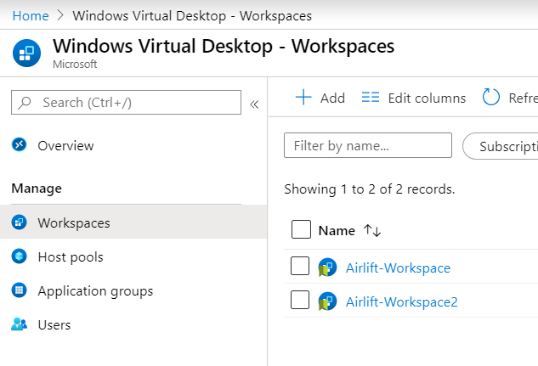
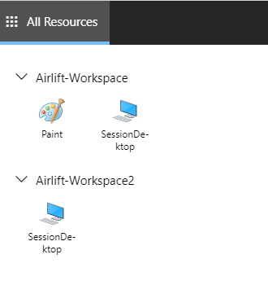
{
All WVD high-level objects
Session host management
User management
RBAC Permission
Diagnostic setting
WVD Portal Centralizes:

Slide 8


WVD Load Balancing Algorithms
4
5
2
1
2
3
1
3
Breadth-first load balancing
Distributes new user sessions across all available session hosts in the host pool
Depth-first load balancing
Distributes new user sessions to an available session host with the highest number of connections but has not reached its maximum session limit threshold

Slide 9
WVD Object model - comparison
V1 object model
V2 object model
Tenant group
Subscription
Lighthouse
Tenant
SSO
Log Analytics
Workspace
Host pool
App group
Registered app groups
SSO
RemoteApp/ Desktop
Host pool
List of app groups
Ref to workspace
Assigned users
Session host
Session host
App group
RemoteApp/ Desktop
Assigned users
User sessions
User sessions
Note: All resources will have resource group and location associated with it
Notes:
Tenant Group – V1 Preview your Tenant was placed in the “Microsoft Internal” Tenant Group.
If you have created your own since it would be in the “Default Tenant Group”
In V2 each resource is an non-hierarchical independent ARM object and behaves as such, I.e., each resource can be in its own location, its own Resource Group. However there are some limitations to the placement enforced by the WVD management service not the Azure fabric.
Plus you need to connect or assign the objects together where appropriate.

Slide 10
Demo - Spring Update Management via WVD Portal

Slide 11
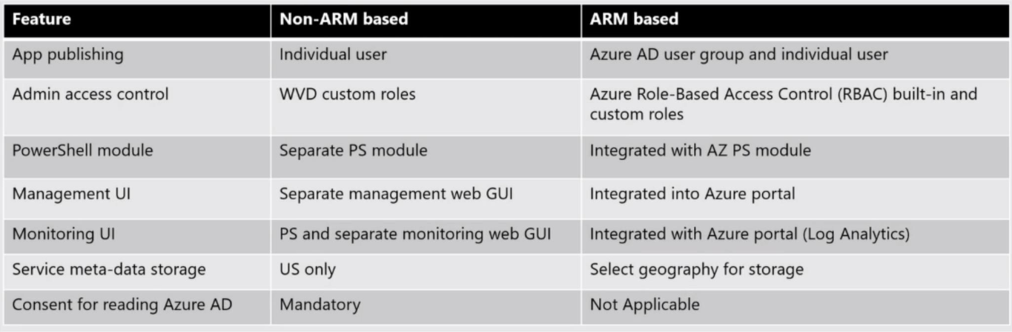
Obligatory Summary Slide

Slide 12
Diagnostics comparison
 | Diagnostics V1 Production | Diagnostics V2 Preview
Access Diagnostics Data | PowerShell/RestAPI Log Analytics New/set-RdsTenant | Through Azure Monitor: Archive to storage account Stream to event hub Send to Log Analytics PowerBI for deep analysis UserVoice Feedback
Data consumption model | Poll | Stream
Notes:
Object is called through rest api or powershell. In new world information is in tables.

Slide 13
Leveraging the service diagnostics
End-to-end user activity tracking (tables prefixed w/WVD)
Administrators managing workspaces
Users subscribing and connecting to published apps or desktops
Checkpoints
Connections
Errors
Feeds
Host registration
Management activities
Tracks successful VM registration with the service
Aggregates and consolidates data into meaningful information
Easy access to errors for troubleshooting
Provides flags if issue requires escalation to Microsoft Support

Slide 14
Log Analytics
Increase familiarity with Kusto
Support for SQL queries
Extensive documentation available that provides
Learning path
Examples
Demo environment with test data

Slide 15
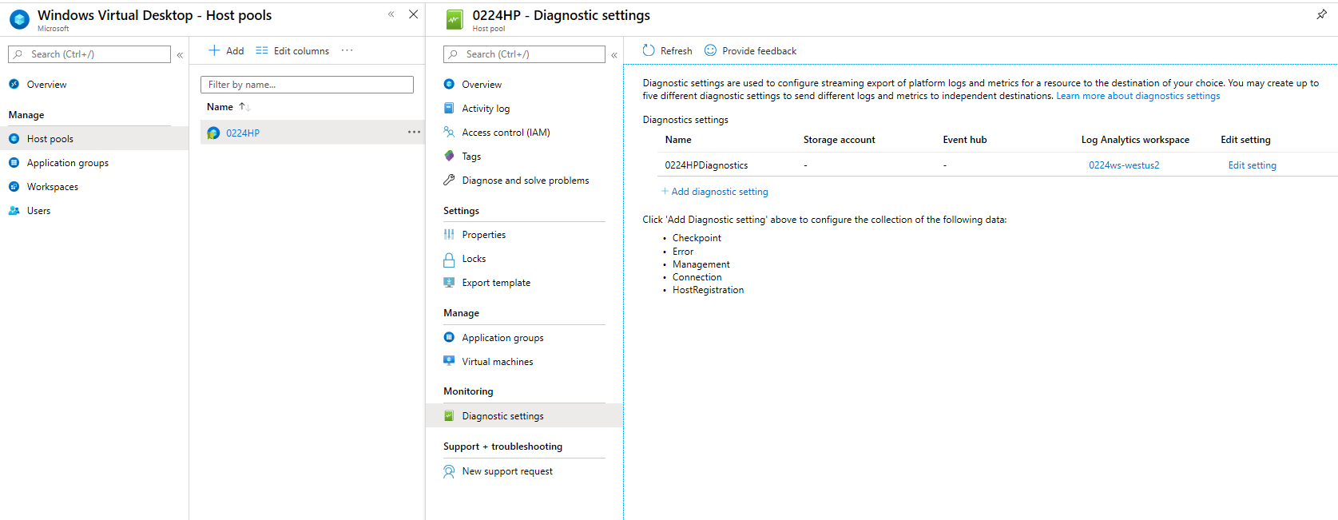
Enable Diagnostics

Slide 16
Enable Diagnostics

Slide 17
Diagnostics out of the box https://docs.microsoft.com/en-us/azure/virtual-desktop/diagnostics-log-analytics#cadence-for-sending-diagnostic-events
WVD uses Azure Monitor for monitoring and alerts
Service creates activity logs for both user and administrative actions in these categories:
Management Activities:
Track whether attempts to change WVD objects using APIs or PowerShell are successful. For example, can someone successfully create a host pool using PowerShell?
Feed:
Can users successfully subscribe to workspaces?
Do users see all resources published in the Remote Desktop client?
Connections:
When users initiate and complete connections to the service.
Host registration:
Was the session host successfully registered with the service upon connecting?
Errors:
Are users encountering any issues with specific activities? Generates a table that tracks activity data as long as the information is joined with the activities.
Checkpoints:
Specific steps in the lifetime of an activity that were reached. For example, during a session, a user was load balanced to a particular host, then the user was signed on during a connection, and so on.
Start w/Example Queries here: https://docs.microsoft.com/en-us/azure/virtual-desktop/diagnostics-log-analytics#example-queries

Slide 18
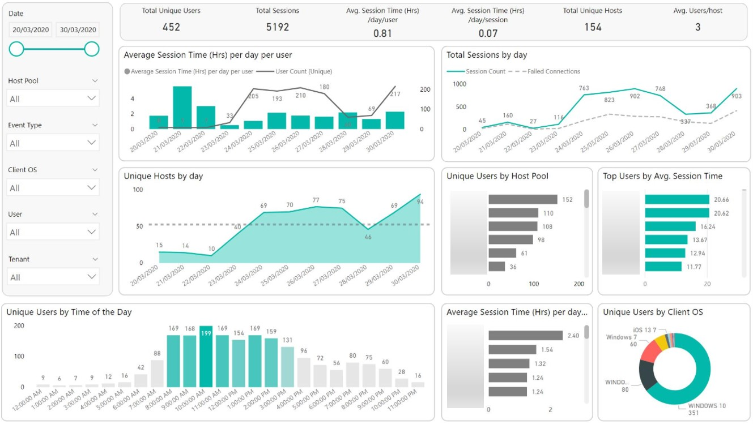
PowerBI Integration https://github.com/zrahui/RemoteWorkPerth/tree/master/WVD/wvd-powerbi

Slide 19
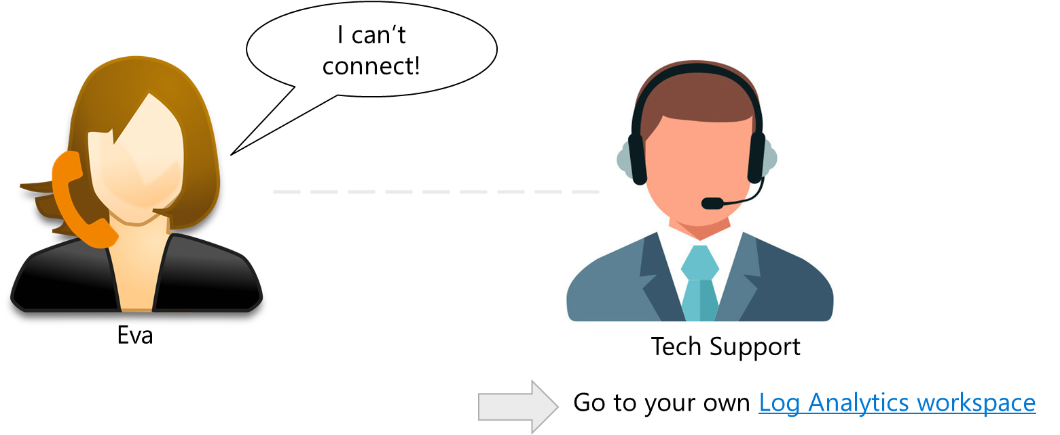
Scenario

Slide 20
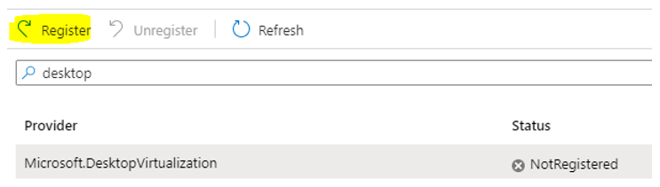
WVD V2 considerations
Location restrictions:
The Host Pool needs to be in the same Azure region as the Workspace*
The Session Hosts within the Host Pool must be in the same GEO as the Host Pool
Application Groups need to be associated with a Host Pool during its creation
Consumes AAD Tenant the Azure Subscription is linked to –not configurable
You must associate Application Groups with a Workspace in order for them to be presented to WVD Clients
URL Accesses to V2 is different:
WVD Spring Update management portal requires using a specific URL (for now)
A specific RDWeb Client URL is the only supported Client (for now)
Enabling V2 requires registering
new Resource Provider
Notes:
* The host pool creation requires a Workspace and the portal will only list Workspaces in the same region as the Host pool is being created within.

Slide 21

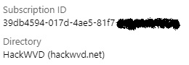




WVD V2 AAD Requirements
hackwvd.net AAD
AAD linked to Subscription hosting WVD VMs
Azure Subscription
AAD Connect
Users and Admins of WVD must be in AAD linked to HostPool Subscription
Manual work-arounds exist (but are harder)
WVD V2 Objects
onprem. hackwvd.net AD
Domain-joined Session Hosts
Notes:
Cleanest but will consume your credits the quickest.

Slide 22
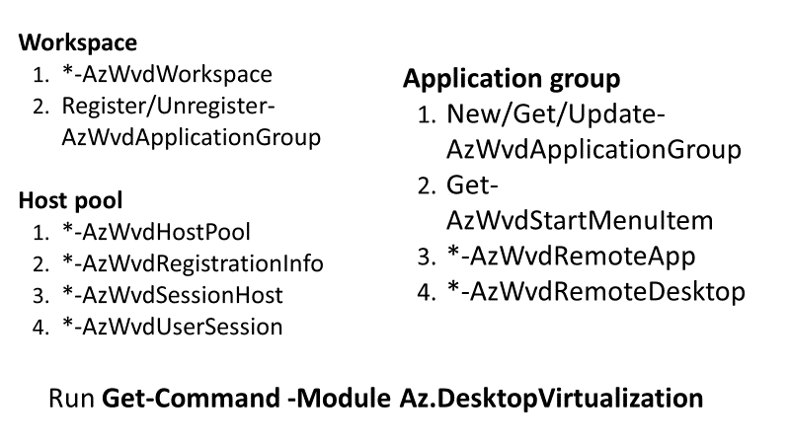
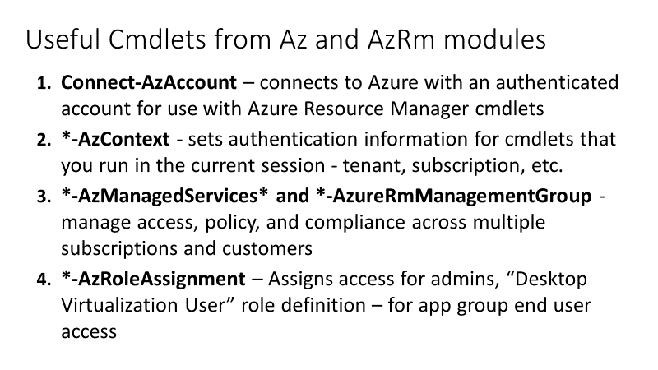
PowerShell update
Integrated into the Az PS module
Cmdlets are in the form [Verb]-AzWvd[Noun]
Can use existing Azure cmdlets (Az or AzureRm module) when capabilities exist

Slide 23
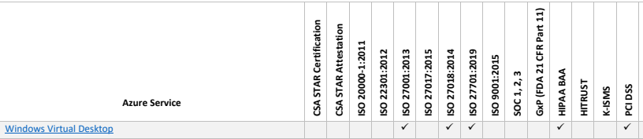
Security Updates
WindowsVirtualDesktop service tag
Limits internet egress traffic from your VMs to specific IP addresses in Azure
Simplifies deployment of an Azure Firewall in conjunction with WVD
Ability to add groups of users to WVD using Azure AD groups
Support for static or dynamic conditional access policies
Support for mandating multi-factor authentication (MFA)
Integration with RBAC & analytics for greater administrative control over user permissions (audit, Azure Advisor, etc.)
Choose geography to store service metadata for the best possible regulatory compliance and performance
WVD now in-scope for HIPAA BAA per April Audit results

Slide 24
Preview: Migration Goals WVD v1 to WVD v2
Reminder: WVD v2 is Public Preview, do not migrate your production WVD v1 Tenants until GA.
Customers have created objects using non-ARM and have significant investment in them
Goals:
Customers can migrate their existing non-ARM environment to WVD ARM – full environment or copy high-level objects with configured properties
Customers can easily migrate without too much complexity
Non-goals:
Migrating WVD objects to non-US locations

Slide 25
Overview: Migration from non-ARM to ARM WVD
If Satisfied - Complete Host Pool Migration
Start Host Pool Migration
STEP
01 b
Add users to ARM app group - validation
STEP
03
STEP
04 b
STEP
01 a
Add Azure info – subscription, resource group
STEP
02
Add ALL users/ user groups to ARM app groups
STEP
04 a
Not satisfied – Revert Host Pool Migration
This step would require privs in both non-ARM and ARM, target host pool, Tenant (nonARM), destination RG, Workspace and copy, move or do not create user authorizations
Note:
Management tools need to be ported to ARM to finalize migration
VMs are not affected
Connectivity will not be affected

Slide 26
Big Rocks – Curb Your Enthusiasm ☺
V 2.0 in Preview May/June – target GA late June/ early July
Summertime is the right time to start leveraging Spring Update in Production, post-GA
Production deployments until v 2.0 GA's should still deploy using V 1.0 (support)
New PowerShell for Spring Update follows in a few days (not today)
GEO retention of data US-only today; other GEOs over next few days
For PRD support TODAY where you need v2-like features, consider other Partner management planes
Citrix
VMWare
CloudJumper (just acquired by NetApp https://seekingalpha.com/news/3565972-netapp-acquires-cloudjumper)
Nerdio
Researching Image Swap / Management options & PG guidance on patching vs. swapping images
Teams support & InTune support still work in progress
Non-ARM v1 WVD plan for deprecation still TBD based on GA
Will be phased over many months (e.g., warnings, community outreach notifications)
Goal is to provide PowerShell migration tools (current to vNext)

Slide 27
WVD – Super Inter-dependence!!
WVD
WVD
App Services
Mac Client
iOS Client
Android Client
Linux Client
Windows Client
HTML5 Client
RD Core SDK
WVD Agent
WVD Stack
FSLogix
Agent
Mngmt Tools
Azure Marketplace
Windows 10 multi-session
WVD incremental progress may appear slow
Each dependency has a different:
release cadence
sign-off process
compliance requirements
servicing model
Notes:
Upcoming additional investments: STUN / TURN Servers

Slide 28
Learn More
WVD V2 announcement: https://www.microsoft.com/en-us/microsoft-365/blog/2020/04/30/enable-remote-work-faster-new-windows-virtual-desktop-capabilities/
Excellent Overview/Details:
https://techcommunity.microsoft.com/t5/windows-it-pro-blog/getting-started-windows-virtual-desktop-arm-based-azure-portal/ba-p/1374466
https://www.christiaanbrinkhoff.com/2020/05/01/windows-virtual-desktop-technical-2020-spring-update-arm-based-model-deployment-walkthrough/
Deep dive into documentation: https://aka.ms/wvdgetstarted
Submit ideas on UserVoice: https://aka.ms/wvdfbk
Exchange with experts on TechCommunity: https://aka.ms/wvdtc
Leverage partners: https://aka.ms/wvdpartner

Slide 29
Q & A

Slide 30
But Wait... There's More!

Slide 31
MSIX – A New Packaging Solution
New packaging format (exe, MSI, click once, AppV, etc.)
Declarative install = clean uninstall (no registry rot/left over artefacts)
Simpler packaging and deployment
OS managed
Apps are installed per use
Tamper protection
Once an app is converted into MSIX, repackaging is no longer required
Base app and customization can be updated within MSIX container without repackaging
Notes:
Level set on MSIX
App Packaging is fundamental to *all* Enterprise IT​
Designed for XP era IT lifecycle​
Packaging is done by IT pros (or SI’s) *not* developers​
Today packaging is either MSI or App-V​
Applies to internal LOB & 3rd party apps (repackaging)

Slide 32

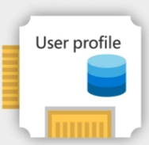



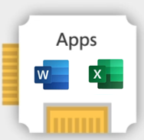

MSIX app attach process flow
1 – User authenticates and obtains WVD feed
4 – Read apps assigned to user
2 – Broker connection to VM in host pool
5 – Register applications
3 – Load user profiles
3
4
1
2
WVD
5
User
Host pool
File share
Notes:
Conceptual connection flow
Ask Chris if he wants to see the proposed publish flow

Slide 33

Traditional application delivery vs. MSIX app attach
Traditional (personal desktops)
MSIX app attach + user profile roaming (pooled desktops)
VM 1
VM 2
VM 3
VM 1
VM 2
VM 3
Golden Image
Image for Sales
Image for HR
Image for ENG
User Profile
User Profile
FSLogix User Profile Roaming
User Profile
User Profile
User Profile
User Profile
User Profile
Common Apps
Common Apps
Common Apps
User Profile
User Profile
Common Apps
Common Apps
Common Apps
Common Apps
Sales App 1
HR App 1
ENG App 1
HR App 1
HR App 1
Sales App 2
HR App 2
ENG App 2
HR App 2
HR App 2
Sales App 1
Sales App 1
MSIX App Attach
Sales App 2
Sales App 2
ENG App 1
ENG App 1
ENG App 2
ENG App 2
Sales User
HR User
ENG User
Sales User
HR User
ENG User
Notes:
Traditional vs MSIX+FSlogix

Slide 34
App Management Strategies in VDI/SBC
Goal: Achieve cost savings by creating a pool of VMs that can scale up or down as needed to meet current demand.
 | Pros | Cons | Usage
Imaging | Reliably create ready to use VMs | New image is required for each app or OS update, costly maintenance | ~29%
Central Management (e.g. SCCM, Intune, BigFix, etc.) | Reduces footprint & maintenance costs by decoupling Image & Apps | Long set up times for new VMs Uncommon in virtual environments | ~26%
Dynamic App Provisioning (e.g. App Attach, Liquidware) | Reduces maintenance costs by decoupling OS & Apps “Instantaneous” install times since only required bits needed | Win32 Applications require sequencing into a different format unless MSIX natively | ~10%
Others (e.g. custom scripting, chocolatey, puppet, etc.) |  |  | ~35%
Source: VDI Like a Pro End User Computing State of the Union 2019, Aug 2019

Slide 35
Dynamic app provisioning comparison: app layering vs. MSIX app attach
 | App layering | MSIX app attach
Format | Different app layering technologies require different proprietary formats. | Works with native MSIX package format
Overhead | Proprietary formats require sequencing and repackaging per update. | Apps published as MSIX do not require repackaging.
Ecosystem | N/A | MSIX is MSFT’s mainstream technology which is getting adopted by key ISV partners and in-house apps (e.g. Office). MSIX can be used across virtual desktops or physical Windows end points.
Infrastructure | Additional infrastructure required (servers, clients, etc.) | Storage only
Administration | Requires maintenance and update | Simplifies app updates
Experience | Impacts logon time. Boundary exists between OS state/app state/user data. | Apps delivered via MSIX app attach are indistinguishable from locally installed applications.
Vendors | Citrix App Layering (Unidesk), VMware App Volumes, Liquidware | MSFT
Cost | Next section

Slide 36
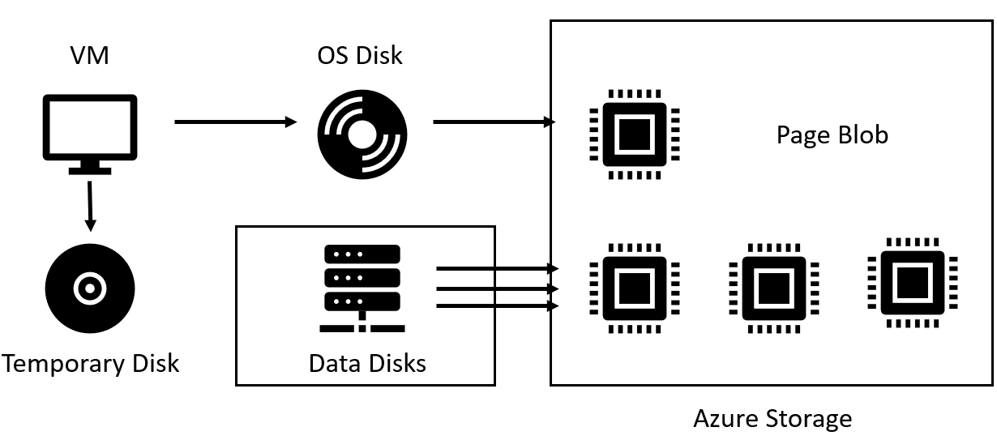


Sample scenario
Use case
100 users / 10 VMs
10 users per VM
10GB apps per user*
30 GB user profile
20GB apps per VM
Standard AF**
Traditional approach for customizing VMs
Offloading user data/profiles with FSLogix
FSLogix + MSIX app attach
OS footprint | per VM apps | per User apps | Apps on AF | User profile/data | User data on AF | Estimated VM disk size | Azure disk sizes | Disk Type | VM storage cost** | AF Cost | Total Storage Cost
30 GB | 20 GB | 100 GB | X | 300 GB | X | 450 GB | 512 GB | P20 (Managed) | $66.56 | X | $66.56
30 GB | 20 GB | 100 GB | X | X | 300 GB | 150 GB | 256 GB | P15 (Managed) | $34.56 | $18 | $52.56
30 GB | 20 GB | X | 100 GB | X | 300 GB | 50 GB | 64 GB | P6 (Managed) | $9.29 | $18 + $6 | $33.29
Notes:
Infrastructure cost
Storage cost only
Scenario 100 user 10 VMs
Assuming 30GB user profiles 30GB application
*per user apps – not all apps can be installed per machine due to ISV implementation
**AF standard tier is suitable for this scenario
With premium
FSLogix AF data cost 72*
FSLogix + AppAttach AF app cost 24*
Data from:
Azure Disks - https://azure.microsoft.com/en-us/pricing/details/managed-disks/
Azure Files - https://azure.microsoft.com/en-us/pricing/details/storage/files/
We all know the benefits of Windows 10 Multi-Session vs. dedicated, personal Windows 10.
MSIX app attach drives cost savings further. In a pay-as-you-go IaaS model, this means lower TCO to customers. In a fixed priced IaaS model, this means lower COGS to Microsoft.
MSIX app attach saves to two types of cost elements: 1) Infrastructure cost, 2) maintenance cost
As for the infrastructure cost, MSIX app attach, combined with roaming user profile, drives ~13% storage cost savings compared with Windows 10 Multi-Session without it.
As for the maintenance cost, MSIX app attach, combined with Rimo3 testing automation, drives ~35% maintenance cost savings in terms of IT admin costs.

Slide 37
MSIX app attach goals…
Utilize MSIX packages shipped by ISV without having to repackage
Simplify image management by separate application state from OS state
Simplify application delivery*
Simplify application and OS update management
Backwards compatible with legacy packaging formats**
Improve App interoperability
Minimal impact on logon performance
Applicable outside VDI/SBC
Notes:
*not only in VDI
**AppV/MSI/Exe/C2R/C1/Appx >90%

Slide 38
Benefits of MSIX app attach
Simple process and tool
Consume standard MSIX package format – No application repackaging!
Same process for Desktop / Remote App vs Physical desktops - all apps are MSIX
Simplify app updates
app attach applications indistinguishable from locally installed applications
Supersedes the “old” technologies
One package can be used by any number of client machines
Mainstream technology from MS
Microsoft is moving to MSIX
Key partners embrace and extend
Nothing proprietary

Slide 39
MSIX app attach is not…
Application compatibility solution
App-V
No Clients/Server/Infrastructure
Does not provide applications isolation
It does however segregates state from OS
Licensing mechanism
Notes:
*not only in VDI
**AppV/MSI/Exe/C2R/C1/Appx >90%

Slide 40
Thank You!!

